Slide 1
Usability recap
^
Quick
[...Bjørn H. Westh] TID 13-09-2022, ITU CPH

Slide 2
usability recap
Heuristic
Principles
Learnability
Efficiency
Memorability
Absence of Errors
Satisfaction
ID Terminology
Affordances
Signifiers
Mapping
Constraints
Jakob Nielsen Heuristics
Visibility of system status
Match between system and the real world
User control and freedom
Consistency and standards
Error prevention
Recognition Rather than Recall
Flexibility and efficiency of use
Aesthetic and minimalist design
Help users recognize, diagnose, and recover from errors
Help and documentation
[...Bjørn H. Westh] TID 13-09-2022, ITU CPH

Slide 3
Buchanan’s 4 orders of design
1: Signs
2: Things
3: Interactions
4: Systems
Graphics
Symbols & Logos
Text
Colour
Products
Objects
Calculations
Information
Actions
Interfaces
Activities
Conveyance & Education
Environments
Universities
Governments
Companies
Society
Tangible & visible
Abstract & invisible
[...Bjørn H. Westh] TID 13-09-2022, ITU CPH

Slide 4
Buchanan’s 4 orders of design
1: Signs
2: Things
3: Interactions
4: Systems
Graphics
Symbols & Logos
Text
Colour
Products
Objects
Calculations
Information
Actions
Interfaces
Activities
Conveyance & Education
Environments
Universities
Governments
Companies
Society
ID Terminology
Jakob Nielsen Heuristics
Heuristic
Principles
Tangible & visible
Abstract & invisible
[...Bjørn H. Westh] TID 13-09-2022, ITU CPH

Slide 5
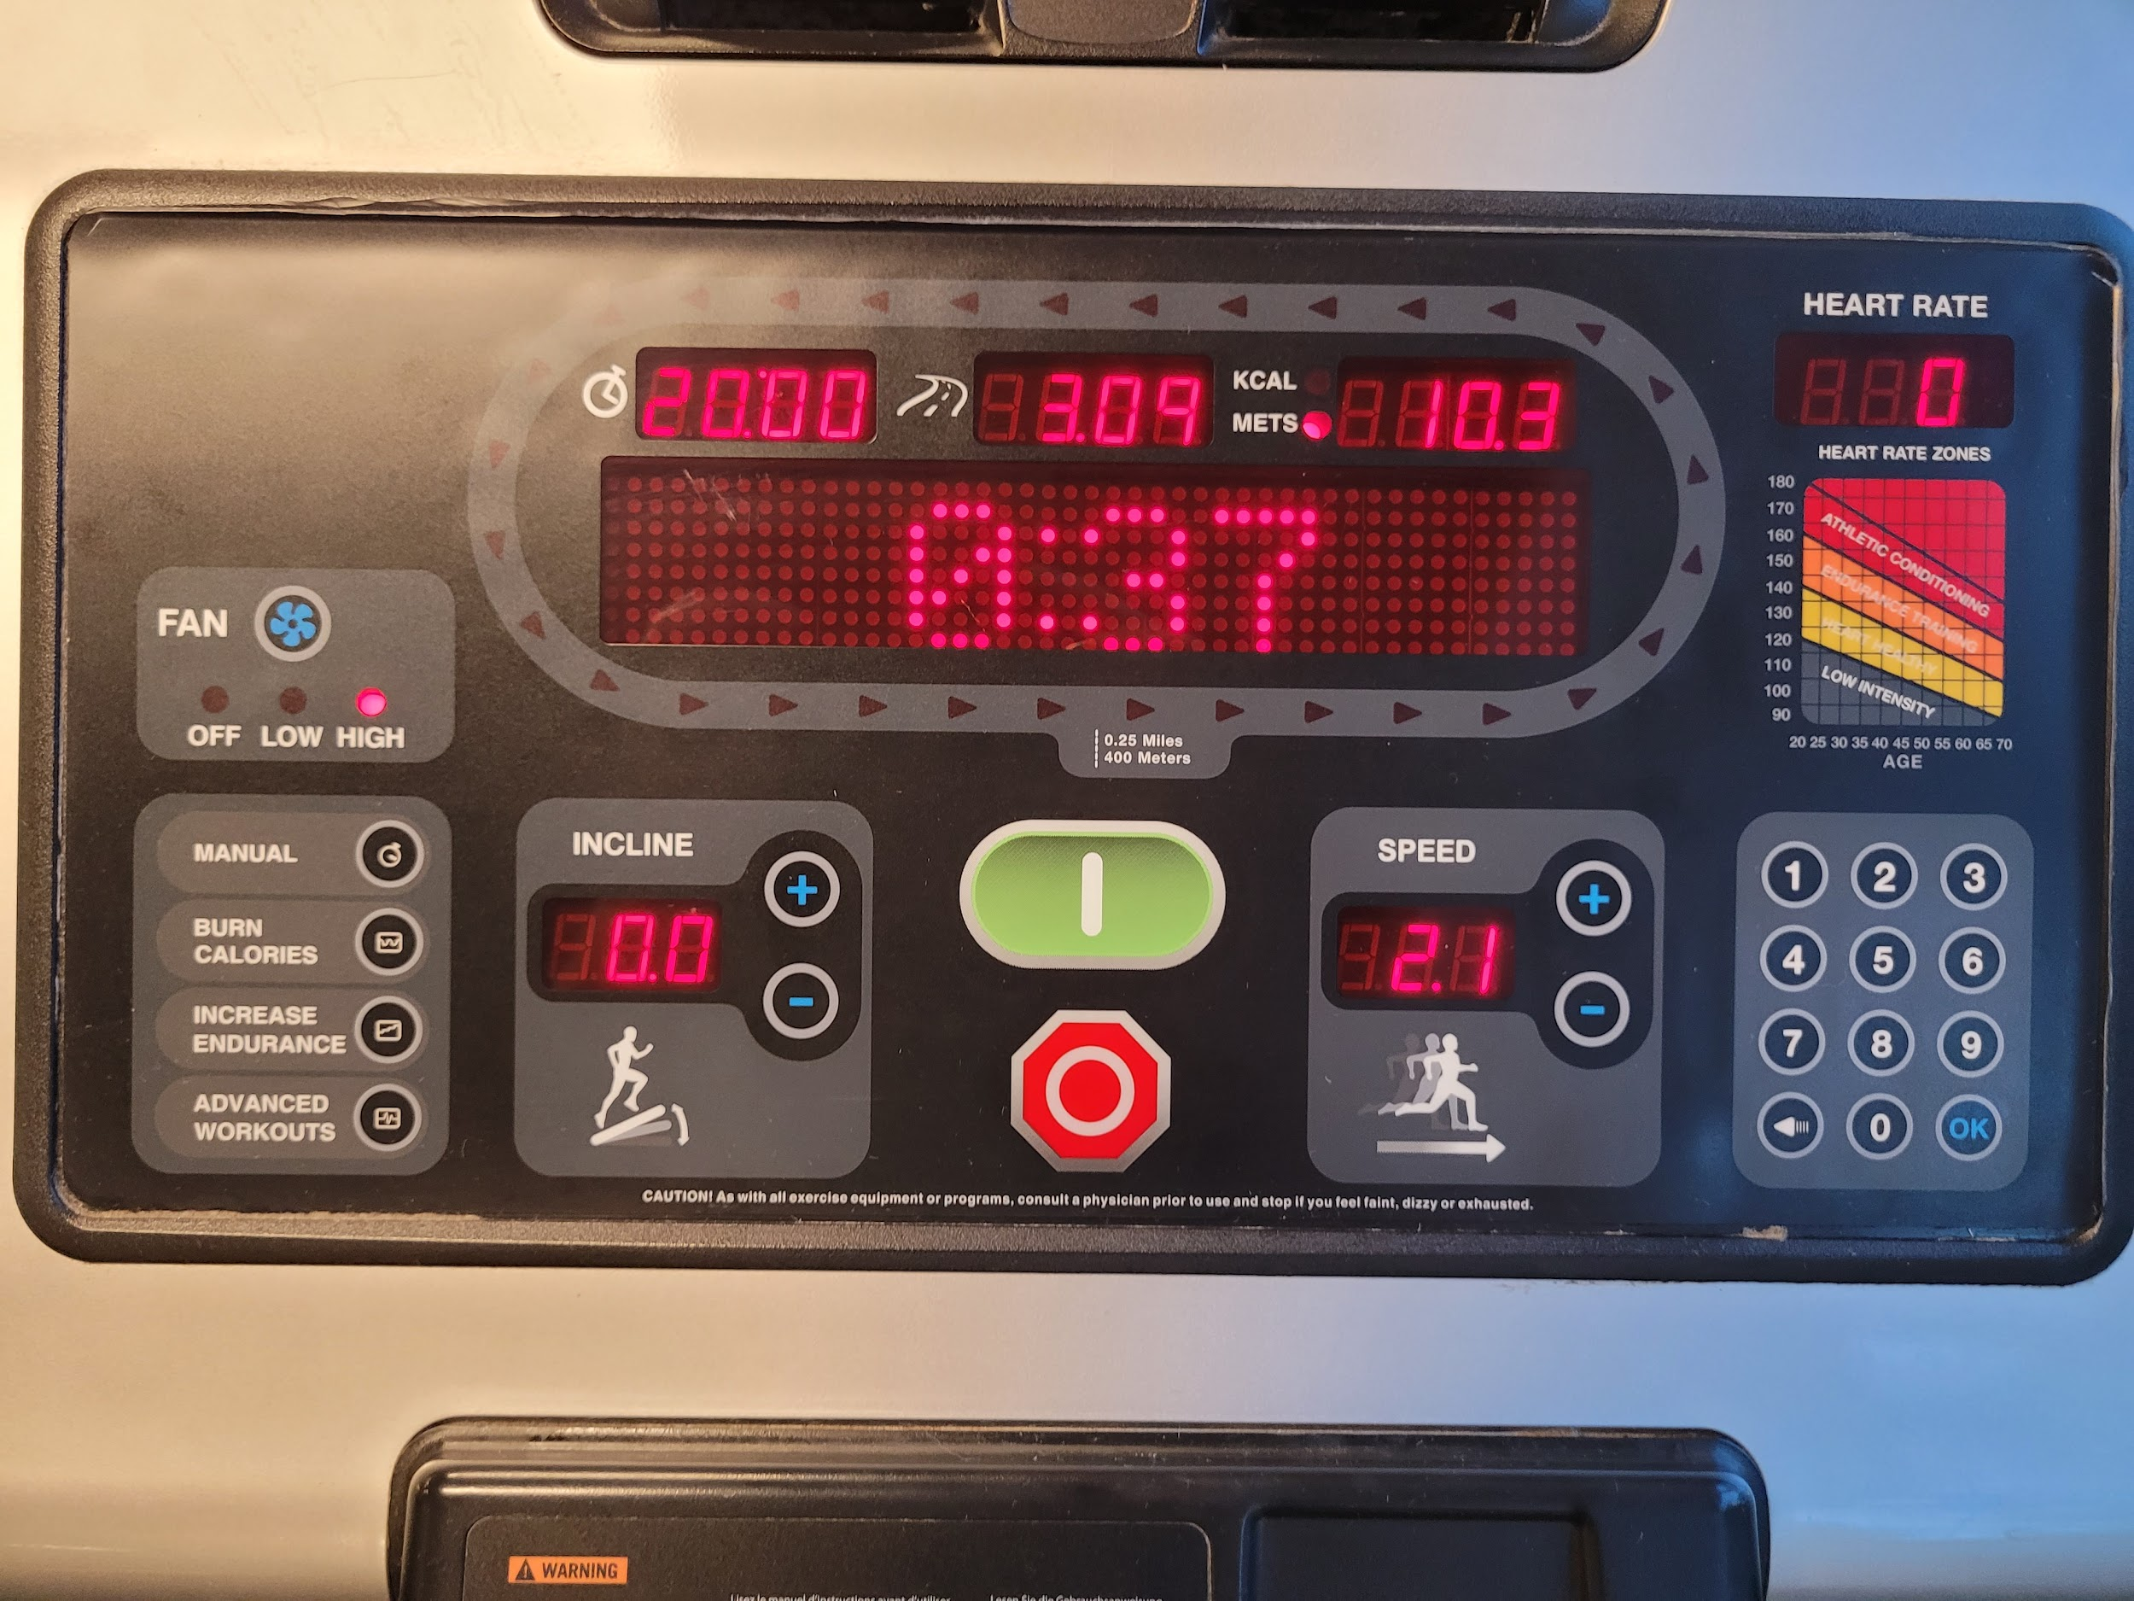
[...Bjørn H. Westh] TID 13-09-2022, ITU CPH

Slide 6
The Gestalt Principles
[...Bjørn H. Westh] TID 13-09-2022, ITU CPH

Slide 7
gestalt principles
Proximity
Closure
Similarity
Common Region
Continuity
Figure and Ground
Symmetry
Common Fate
[...Bjørn H. Westh] TID 13-09-2022, ITU CPH

Slide 8
gestalt principles
Proximity
Closure
Similarity
Common Region
Continuity
Figure and Ground
Symmetry
Common Fate
Law of Proximity
[...Bjørn H. Westh] TID 13-09-2022, ITU CPH

Slide 9
gestalt principles
Proximity
Closure
Similarity
Common Region
Continuity
Figure and Ground
Symmetry
Common Fate
Law of Proximity
[...Bjørn H. Westh] TID 13-09-2022, ITU CPH

Slide 10
gestalt principles
Proximity
Closure
Similarity
Common Region
Continuity
Figure and Ground
Symmetry
Common Fate
Law of Closure
[...Bjørn H. Westh] TID 13-09-2022, ITU CPH

Slide 11
gestalt principles
Proximity
Closure
Similarity
Common Region
Continuity
Figure and Ground
Symmetry
Common Fate
Law of Closure
[...Bjørn H. Westh] TID 13-09-2022, ITU CPH

Slide 12
gestalt principles
Proximity
Closure
Similarity
Common Region
Continuity
Figure and Ground
Symmetry
Common Fate
Law of Closure
[...Bjørn H. Westh] TID 13-09-2022, ITU CPH

Slide 13
gestalt principles
Proximity
Closure
Similarity
Common Region
Continuity
Figure and Ground
Symmetry
Common Fate
Law of Similarity
[...Bjørn H. Westh] TID 13-09-2022, ITU CPH

Slide 14
gestalt principles
Proximity
Closure
Similarity
Common Region
Continuity
Figure and Ground
Symmetry
Common Fate
Law of Similarity
[...Bjørn H. Westh] TID 13-09-2022, ITU CPH

Slide 15
gestalt principles
Proximity
Closure
Similarity
Common Region
Continuity
Figure and Ground
Symmetry
Common Fate
Law of Similarity
[...Bjørn H. Westh] TID 13-09-2022, ITU CPH

Slide 16
gestalt principles
Proximity
Closure
Similarity
Common Region
Continuity
Figure and Ground
Symmetry
Common Fate
Law of Similarity
[...Bjørn H. Westh] TID 13-09-2022, ITU CPH

Slide 17
gestalt principles
Proximity
Closure
Similarity
Common Region
Continuity
Figure and Ground
Symmetry
Common Fate
Law of Similarity
[...Bjørn H. Westh] TID 13-09-2022, ITU CPH

Slide 18
gestalt principles
Proximity
Closure
Similarity
Common Region
Continuity
Figure and Ground
Symmetry
Common Fate
Law of Similarity
[...Bjørn H. Westh] TID 13-09-2022, ITU CPH

Slide 19
gestalt principles
Proximity
Closure
Similarity
Common Region
Continuity
Figure and Ground
Symmetry
Common Fate
Law of Common Region
[...Bjørn H. Westh] TID 13-09-2022, ITU CPH

Slide 20
gestalt principles
Proximity
Closure
Similarity
Common Region
Continuity
Figure and Ground
Symmetry
Common Fate
Law of Common Region
[...Bjørn H. Westh] TID 13-09-2022, ITU CPH

Slide 21
gestalt principles
Proximity
Closure
Similarity
Common Region
Continuity
Figure and Ground
Symmetry
Common Fate
Law of Common Region
[...Bjørn H. Westh] TID 13-09-2022, ITU CPH

Slide 22
gestalt principles
Proximity
Closure
Similarity
Common Region
Continuity
Figure and Ground
Symmetry
Common Fate
Law of Continuity
[...Bjørn H. Westh] TID 13-09-2022, ITU CPH

Slide 23
gestalt principles
Proximity
Closure
Similarity
Common Region
Continuity
Figure and Ground
Symmetry
Common Fate
Law of Continuity
[...Bjørn H. Westh] TID 13-09-2022, ITU CPH

Slide 24
gestalt principles
Proximity
Closure
Similarity
Common Region
Continuity
Figure and Ground
Symmetry
Common Fate
Law of Continuity
[...Bjørn H. Westh] TID 13-09-2022, ITU CPH

Slide 25
gestalt principles
Proximity
Closure
Similarity
Common Region
Continuity
Figure and Ground
Symmetry
Common Fate
Law of Continuity
[...Bjørn H. Westh] TID 13-09-2022, ITU CPH

Slide 26
gestalt principles
Proximity
Closure
Similarity
Common Region
Continuity
Figure and Ground
Symmetry
Common Fate
Law of Figure and Ground
name
Click me
[...Bjørn H. Westh] TID 13-09-2022, ITU CPH

Slide 27
gestalt principles
Proximity
Closure
Similarity
Common Region
Continuity
Figure and Ground
Symmetry
Common Fate
Law of Figure and Ground
name
Click me
[...Bjørn H. Westh] TID 13-09-2022, ITU CPH

Slide 28
gestalt principles
Proximity
Closure
Similarity
Common Region
Continuity
Figure and Ground
Symmetry
Common Fate
Law of Figure and Ground
name
Click me
[...Bjørn H. Westh] TID 13-09-2022, ITU CPH

Slide 29
gestalt principles
Proximity
Closure
Similarity
Common Region
Continuity
Figure and Ground
Symmetry
Common Fate
Law of Symmetry
[...Bjørn H. Westh] TID 13-09-2022, ITU CPH

Slide 30
gestalt principles
Proximity
Closure
Similarity
Common Region
Continuity
Figure and Ground
Symmetry
Common Fate
Law of Symmetry
[...Bjørn H. Westh] TID 13-09-2022, ITU CPH

Slide 31
gestalt principles
Proximity
Closure
Similarity
Common Region
Continuity
Figure and Ground
Symmetry
Common Fate
Law of Symmetry
[...Bjørn H. Westh] TID 13-09-2022, ITU CPH

Slide 32
gestalt principles
Proximity
Closure
Similarity
Common Region
Continuity
Figure and Ground
Symmetry
Common Fate
Law of Symmetry
[...Bjørn H. Westh] TID 13-09-2022, ITU CPH

Slide 33
gestalt principles
Proximity
Closure
Similarity
Common Region
Continuity
Figure and Ground
Symmetry
Common Fate
Law of Symmetry
[...Bjørn H. Westh] TID 13-09-2022, ITU CPH

Slide 34
gestalt principles
Proximity
Closure
Similarity
Common Region
Continuity
Figure and Ground
Symmetry
Common Fate
Law of Common Fate
[...Bjørn H. Westh] TID 13-09-2022, ITU CPH

Slide 35
gestalt principles
Proximity
Closure
Similarity
Common Region
Continuity
Figure and Ground
Symmetry
Common Fate
Law of Common Fate
[...Bjørn H. Westh] TID 13-09-2022, ITU CPH

Slide 36
gestalt principles
Proximity
Closure
Similarity
Common Region
Continuity
Figure and Ground
Symmetry
Common Fate
Law of Common Fate
[...Bjørn H. Westh] TID 13-09-2022, ITU CPH

Slide 37

gestalt principles
Exercise:
Find examples of Gestalt principles in play online (any website)
(Or can you spot one missing somewhere?)
Upload in LearnIT forum “Gestalt analysis” under lecture 3
[...Bjørn H. Westh] TID 13-09-2022, ITU CPH

Slide 38
Break
[...Bjørn H. Westh] TID 13-09-2022, ITU CPH

